Slide 1
Analyzing the Growth of Hybrid and Electric Vehicles in the U.S.
Daniel Mihok, Erin Cunningham, Jae Lee, Sirish Kanukunta

Slide 2
Motivation & Summary
Historical analysis of Hybrid and Electric Vehicle market shares
How do green initiatives vary from state to state?
With the growth in purchases of electric vehicles, how has air pollution been impacted?

Slide 3
Questions & Data
Historical analysis of Electric Vehicle (EV) Market share
With the growth in purchases of electric vehicles, how has air pollution been impacted?
Data sourced from Kaggle “U.S. Pollution Data” (https://www.kaggle.com/sogun3/uspollution/version/1)

Slide 4
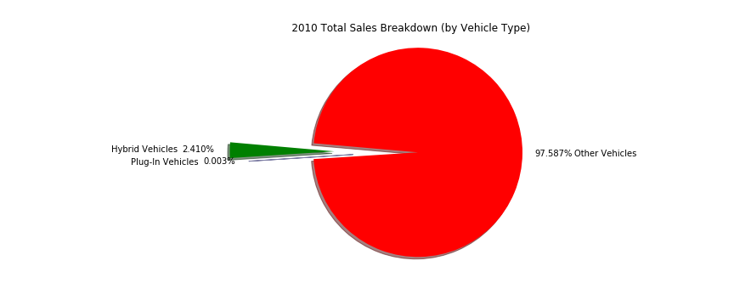
Growth of Hybrid and Electric Vehicle Sales:

Slide 5
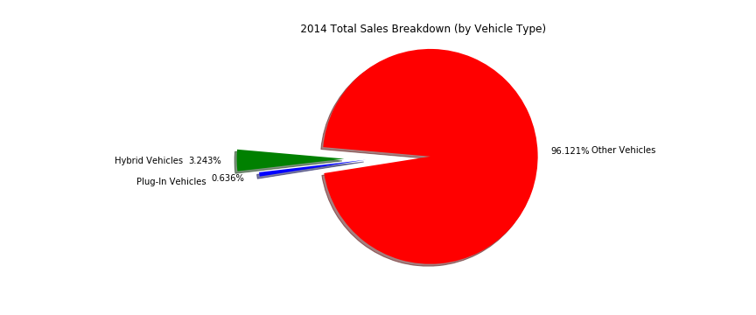
Growth of Hybrid and Electric Vehicle Sales:

Slide 6
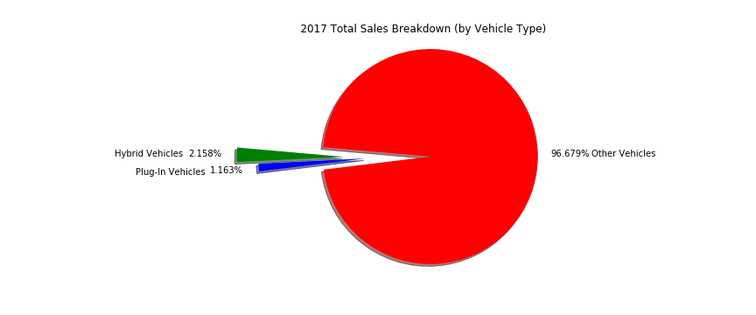
Growth of Hybrid and Electric Vehicle Sales:

Slide 7
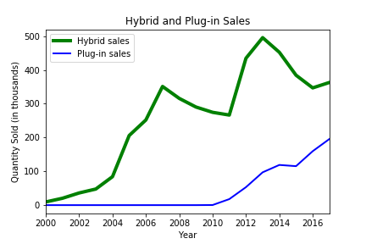
Comparing Sales of Hybrid vs Electric Vehicles:
Why do sales trends vary in this way?

Slide 8
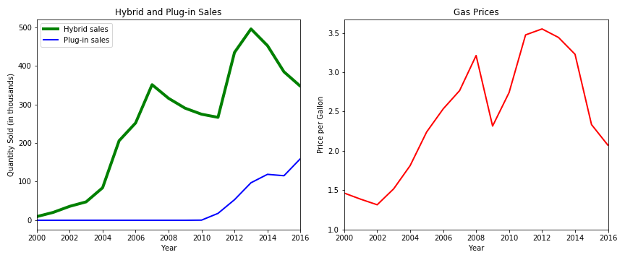
Factors Impacting Sales:
Sales of Hybrid Vehicles appears to be heavily linked to gasoline prices.
Electric Vehicle sales were more resilient to changes in gasoline prices.

Slide 9
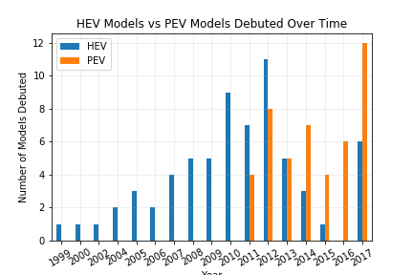

Slide 10
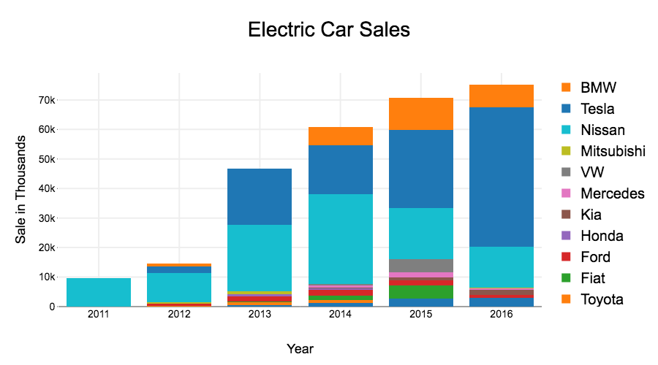

Slide 11
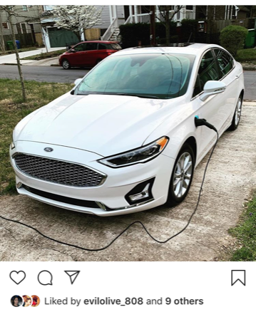
Non-Market Factors Driving Electric Vehicle Adoption
Can I get where I need to go?
How much money are you going to give me?

Slide 12
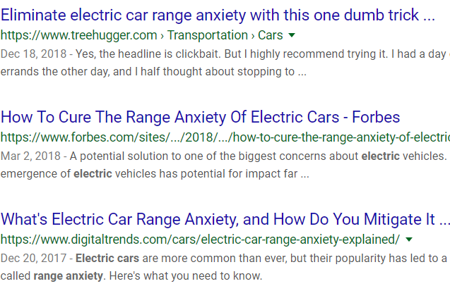
Electric Charging Infrastructure in the U.S.
Most people only drive an average of 50 miles per day
The average miles per battery charge is 200, but…
“Range Anxiety” – The constant fear you will be on the side of the road with a dead battery.
Is there an increase in electric charging stations in the US?
Does this track with overall sales of Plug-In Vehicles?

Slide 13
Gathering and Cleaning Data
National Renewable Energy Laboratory API for Alternative Fuel Stations https://developer.nrel.gov/docs/transportation/alt-fuel-stations-v1/
Parameters
Type of Fuel Station (Electric Only)
Pull data by each State using a FOR loop
Date Opened, Access Type, Lat, Long, State
Challenges
Opened Date pulled as a String

Slide 14
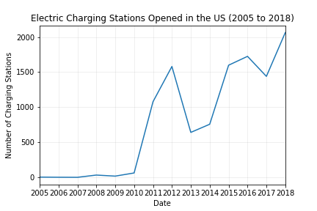

Slide 15
Electric Charging Infrastructure in the U.S.
We see an increase in stations opened that does track with PEV sales
Station openings slightly lead sales.
Largest jump in openings occurs in 2010 – 2011, where PEV sales rise at a slower pace.
Largest increase in stations opened track to the years that the Nissan Leaf and Chevy Volt were introduced (2010 and 2011 respectively) and peaks at the introduction of the Tesla Model S (2012) and again at the introduction of the Model 3 (2016), suggesting station openings are effected by sales and enthusiasm around new car models.

Slide 16
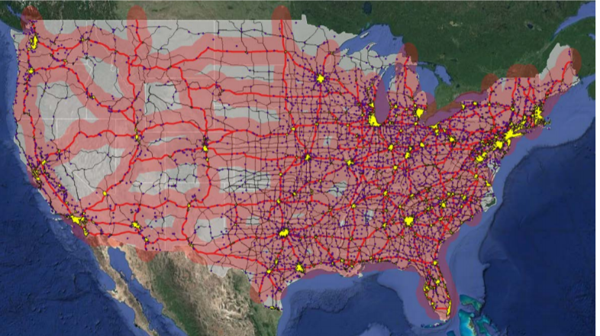
Electric Charging Density in the U.S.
Approximate BEV driving coverage enabled by providing DCFC stations along the U.S. Interstate System from NREL Report on Station Infrastructure

Slide 17
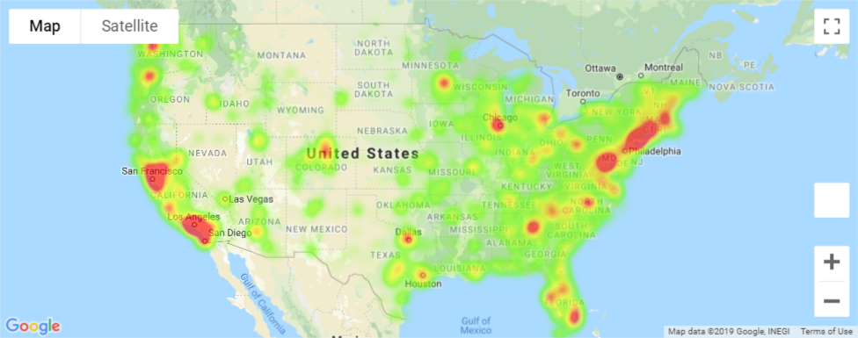
Electric Charging Density in the U.S.

Slide 18
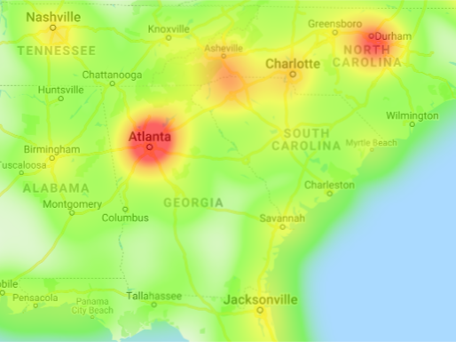
Electric Charging Density in the Southeast

Slide 19
State and Federal Exemptions for Electric and Hybrid Vehicles
Electric vehicles are on average more expensive than gas vehicles of similar quality ranges.

Slide 20
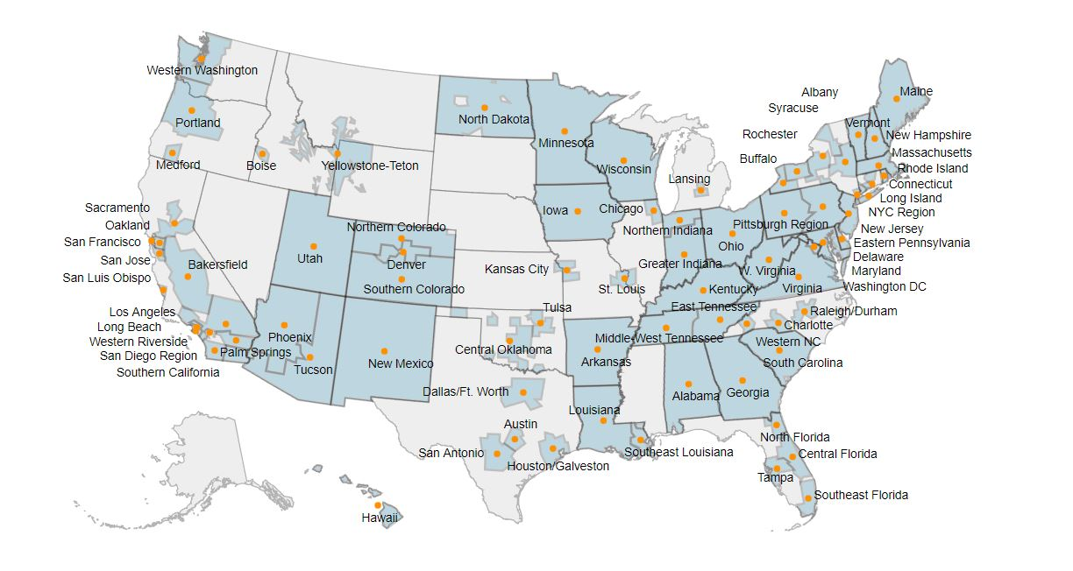

Slide 22
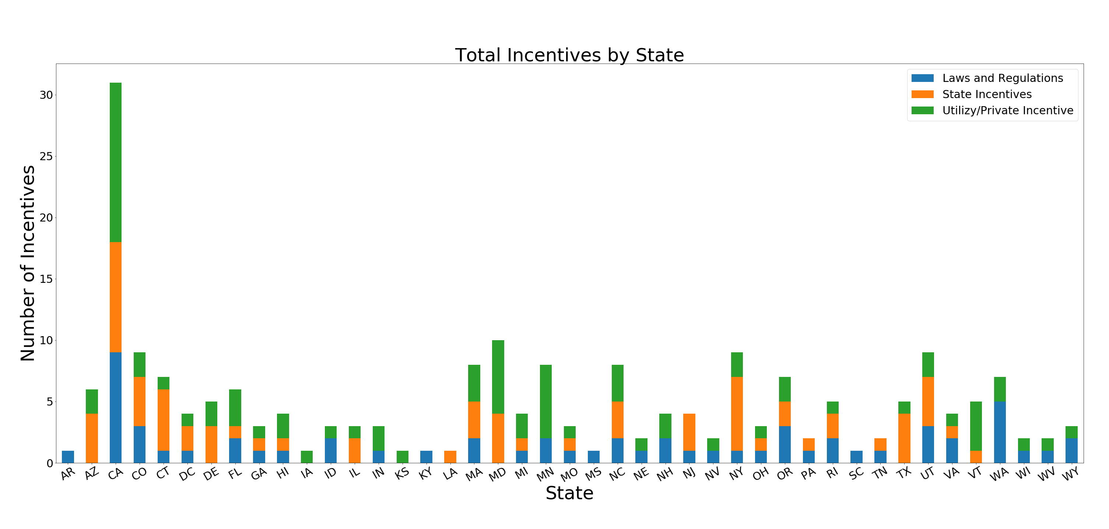

Slide 23
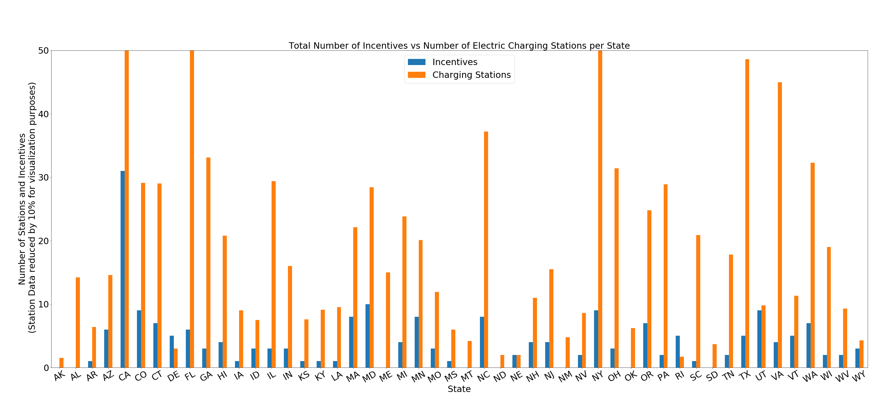

Slide 24
Data Cleanup & Exploration
Read csv into a pandas DataFrame
Get rid of unnecessary data
Handle multiple records for same day (measured in morning and afternoon)
Separate data by Year, and return max AQI value for each pollutant by Year
Using Cartopy, create a US Map Figure while color coding shape based on AQI value for a given year
Using matplotlib, leverage FuncAnimation to create animation that shows Max AQI values for each year from 2000-2016
Repeat for each air pollutant

Slide 25
Four Major Air Pollutants & AQI
Nitrogen Dioxide (NO2)
Form Ozone and can cause lung irritation
Sulphur Dioxide (SO2)
Product of burning sulfur-containing fuels
Carbon Monoxide (CO)
Formed by the combustion of fossil fuels. When inhaled, blocks oxygen from the brain, heart, and other vital organs
Ozone (O3)
Main component of smog and is the product of sunlight and emissions from sources such as motor vehicles and industry
Air Quality Index (AQI)
The higher the AQI value, the greater the level of air pollution.
AQI values are generated for each of the major pollutants, and the highest value is reported daily as an indicator of air quality for that day
Source: https://airnow.gov/index.cfm?action=aqi_brochure.index
https://www.ucsusa.org/clean-vehicles/vehicles-air-pollution-and-human-health/cars-trucks-air-pollution

Slide 26
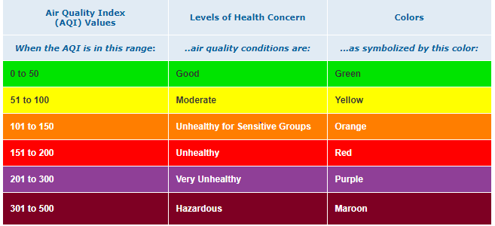
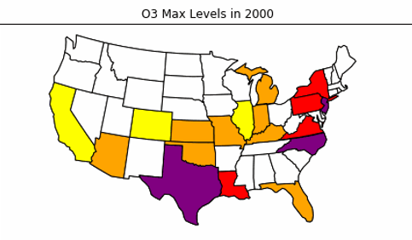
Air Quality Index (AQI) by State & Pollutant
Source: https://airnow.gov/index.cfm?action=aqibasics.aqi

Slide 27
Findings

Slide 28
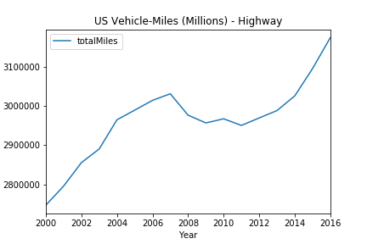
US Vehicle-Miles Trend
Miles traveled via ground vehicles (highway) within the US has increased steadily since 2000
This indicates a negative correlation between air pollution levels and vehicle miles traveled – does this make sense?
Based off this analysis, our next inference would be that the growth of Hybrid/EV sales is dropping pollution levels despite a growth in miles traveled via ground vehicles
Data source: https://www.bts.gov/content/us-vehicle-miles

Slide 29
Post Mortem

Slide 30
Q&A

